Slide 1
Databases 336 fall 2018 bar beer drinker pro
{“Forrest Smith”, “Justin Chan”, “Rahul Boppana”}

Slide 2
Contents
Planning
ER Diagram + Scheme
Data Generation
Verification
Front End Application
URL Linking

Slide 3
Planning
There was a lot of planning involved as to how we would build on the existing BarBeerDrinker database. We first built an ER Diagram for the present tables and built on top of it for each of the new requirements. The main idea we kept in mind while designing the ER Diagram was to try and use as much of the already available information as possibly. For certain sets of data, we found it easier to create a relationship rather than a new entity as so we took that route. After completing this diagram, we had a useful plan on which to build our database.

Slide 4
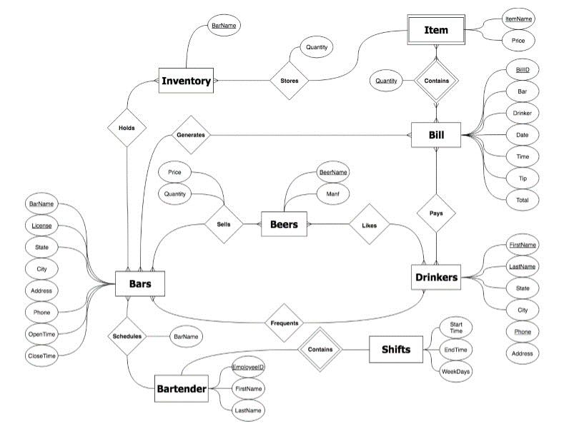
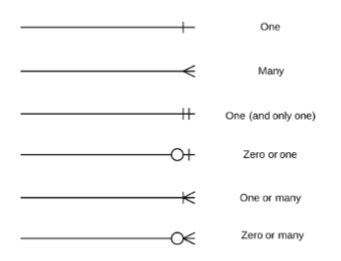
ER Diagram

Slide 5
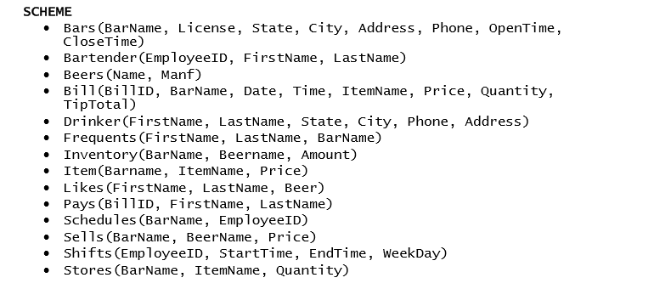
Relational Scheme

Slide 6
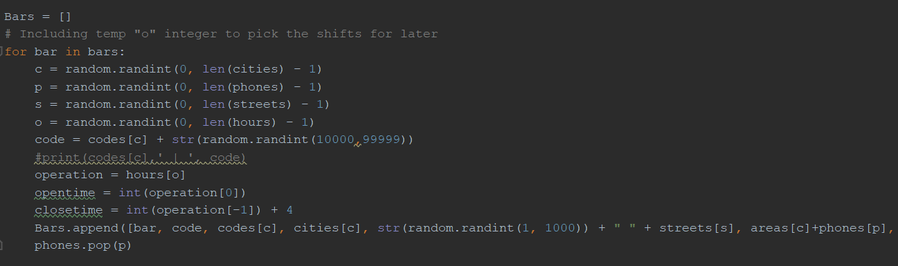
Data Generation
We used python scripts to generate our data.

Slide 7
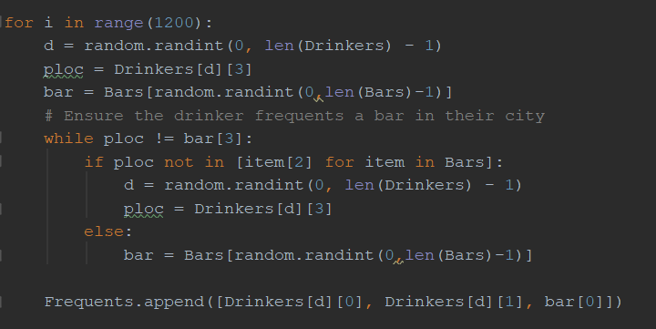
verification
The verification was also built into the python code. It would generate data based on the specified patterns.

Slide 8
Front end Application
We used a vast collection of technologies and frameworks to create our website. Some of these included Angular JS, Node JS, Python, Bootstrap, PrimeNG, HighCharts etc. The website runs due to a server that runs the UI while another application connects to the database and runs queries to retrieve data. The UI is composed of mainly html, css, ts, and json files that enable different pages of the website. Any table, link, dropdown menu, or graph is linked to a service that retrieves the necessary data. After the python app gets and formats the file into json, the data is organized and displayed on the page.

Slide 9
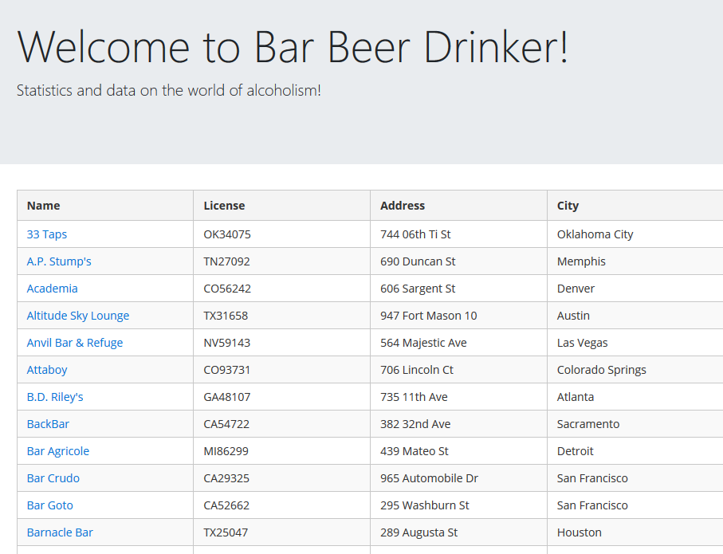
Try it out
Click here to learn more about alcoholism with Bar Beer Drinker Pro!

Slide 10
Thank you

